Slide 1

Living Wages in the gig economy
WageIndicator’s Living Tariff as
a tool for a Living Tariff for gig workers
Presented at
The Oxford Internet Policy & Politics Hybrid Conference (27th January 2024)
Special session - Fairness in Flux: Navigating the Gig Economy through Regulatory Innovation and Collective Bargaining
Paulien Osse
Co-founder, WageIndicator Foundation
Lead, Living Wages, WageIndicator
Daniela Ceccon
Director of Data, WageIndicator Foundation

Slide 2
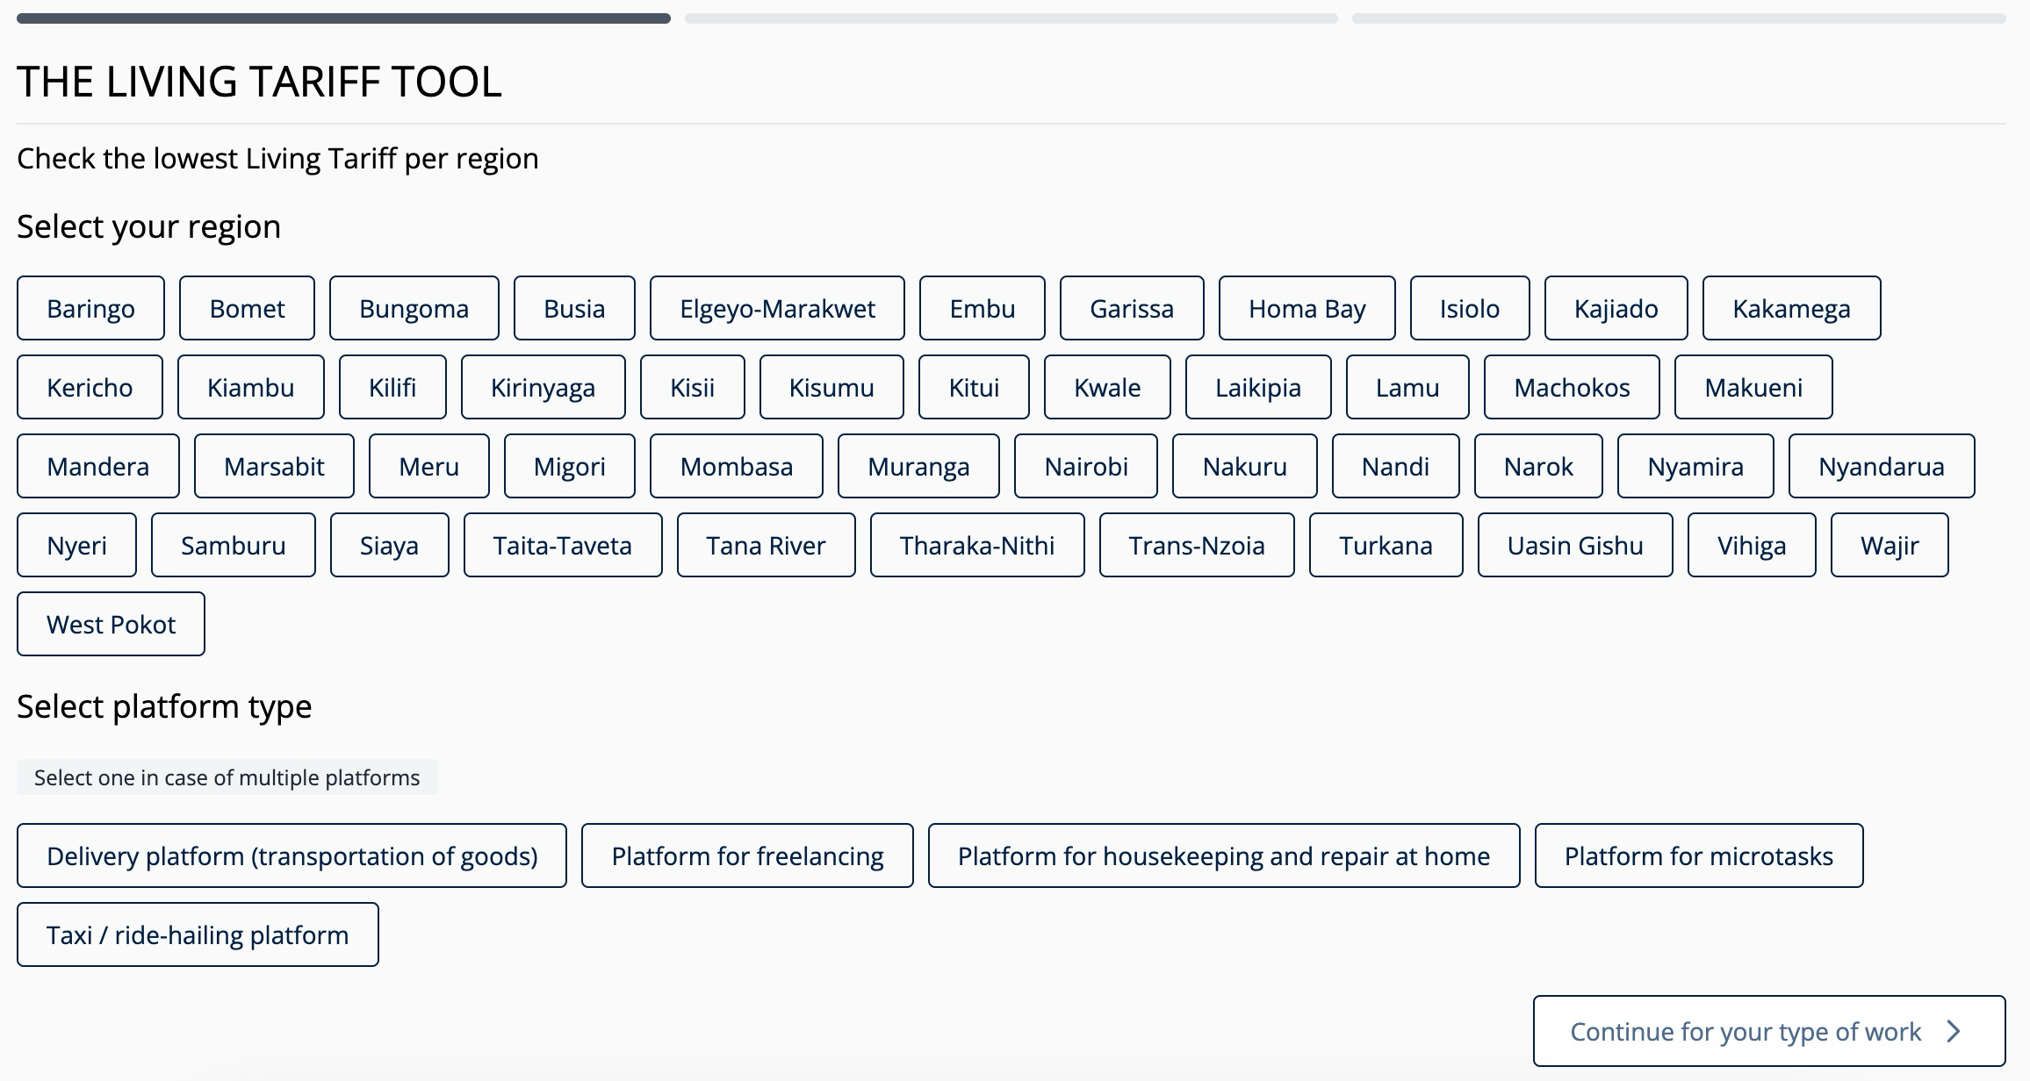
Screenshot from Living Tariff Tool Kenya - https://mywage.org/kenya/salary/living-wages/living-tariff-for-platform-workers-in-kenya (accessed on 19/1/2024)

Slide 3
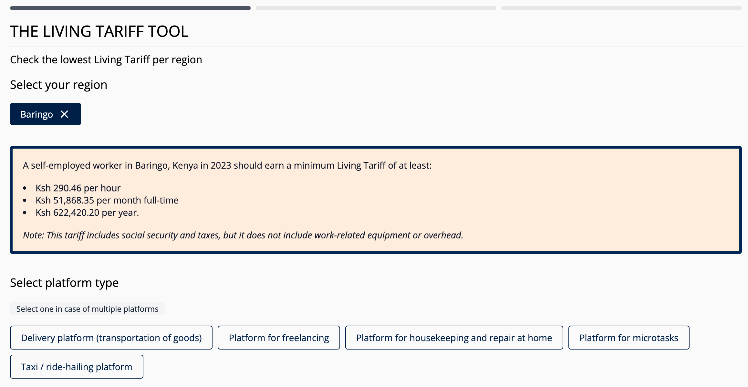

Screenshot from Living Tariff Tool Kenya - https://mywage.org/kenya/salary/living-wages/living-tariff-for-platform-workers-in-kenya (accessed on 19/1/2024)

Slide 4

= Gross Gross Living Wage Per Month (Guidance 2023 or latest quarter)
=
WageIndicator Living Wage + Social Security Due by the Employer
Note: WageIndicator Living Wage includes cost of living and taxes and social security due by the employee
Screenshot from Living Tariff Tool Kenya - https://mywage.org/kenya/salary/living-wages/living-tariff-for-platform-workers-in-kenya (accessed on 19/1/2024)

Slide 5
Note:
Taxes and social security costs are recalculated throughout the tool (they are % that apply to the total)
The hourly Living Wage is calculated from the monthly Living Wage as follows:
  Monthly LW / 4.333 weeks in a month / normal working hours in a week (45 for Kenya)
The yearly Living Wage is calculated from the monthly Living Wage as follows:
  Monthly LW * 12 months in a year.
Screenshot from Living Tariff Tool Kenya - https://mywage.org/kenya/salary/living-wages/living-tariff-for-platform-workers-in-kenya (accessed on 19/1/2024)

Slide 6
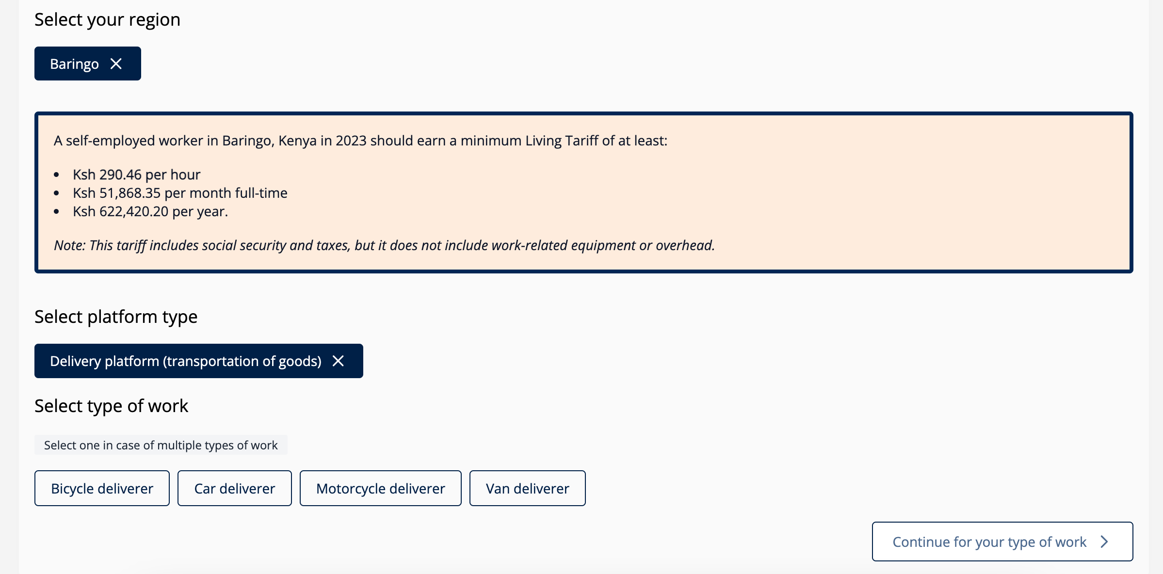


Screenshot from Living Tariff Tool Kenya - https://mywage.org/kenya/salary/living-wages/living-tariff-for-platform-workers-in-kenya (accessed on 19/1/2024)

Slide 7
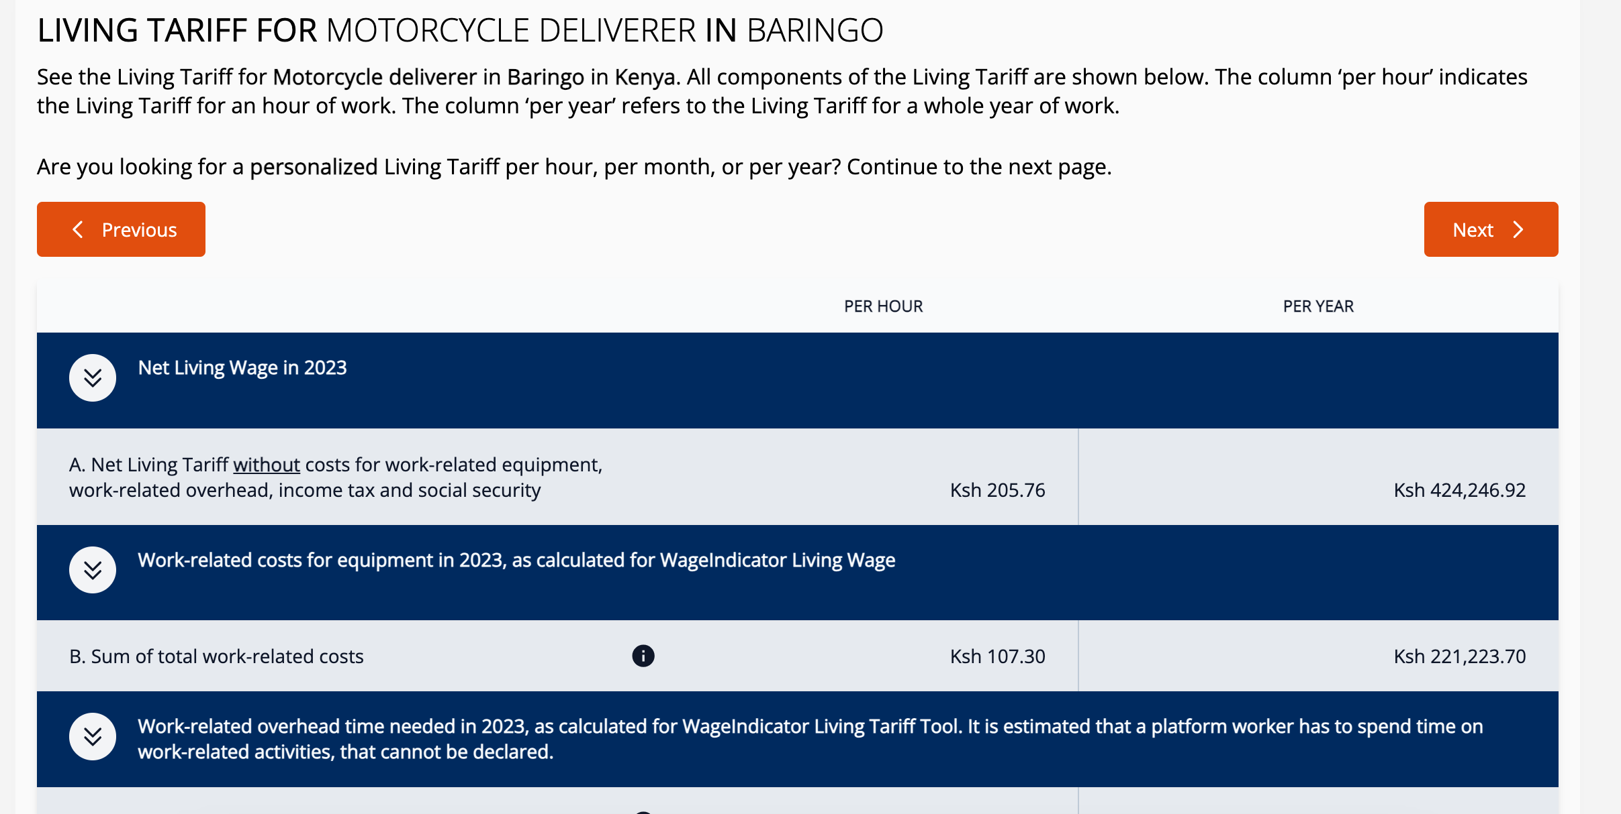


Screenshot from Living Tariff Tool Kenya - https://mywage.org/kenya/salary/living-wages/living-tariff-for-platform-workers-in-kenya (accessed on 19/1/2024)

Slide 8
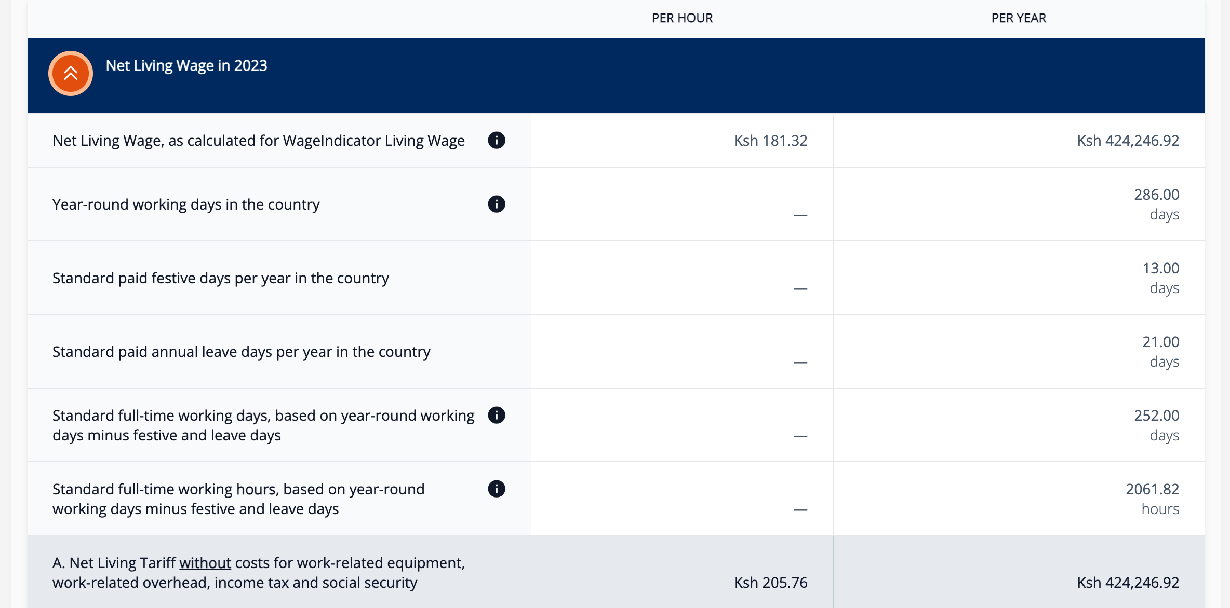






Screenshot from Living Tariff Tool Kenya - https://mywage.org/kenya/salary/living-wages/living-tariff-for-platform-workers-in-kenya (accessed on 19/1/2024)

Slide 9
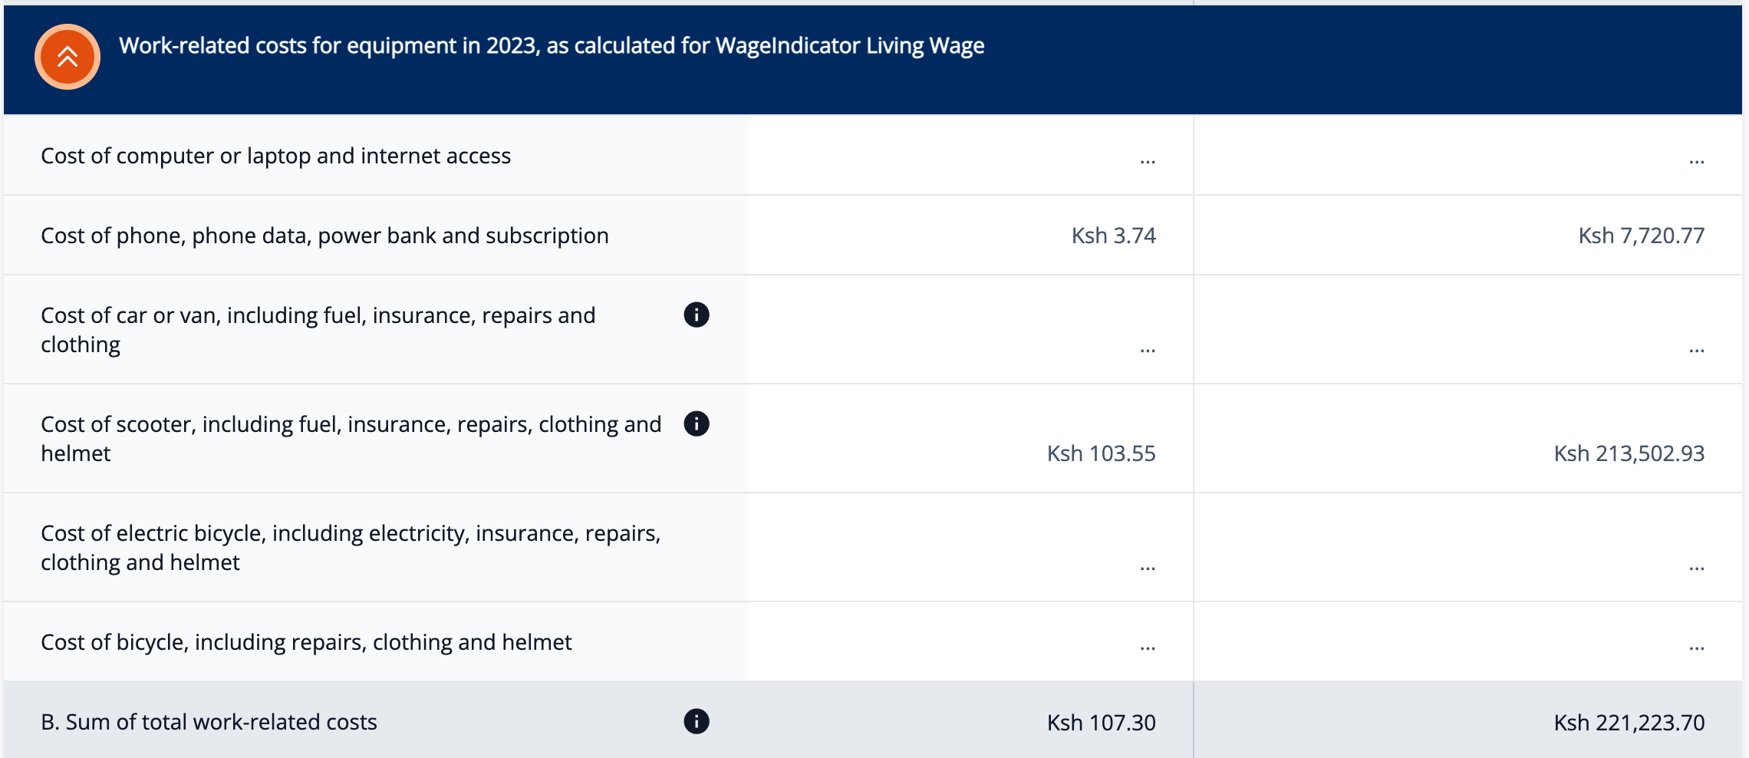





Screenshot from Living Tariff Tool Kenya - https://mywage.org/kenya/salary/living-wages/living-tariff-for-platform-workers-in-kenya (accessed on 19/1/2024)

Slide 10
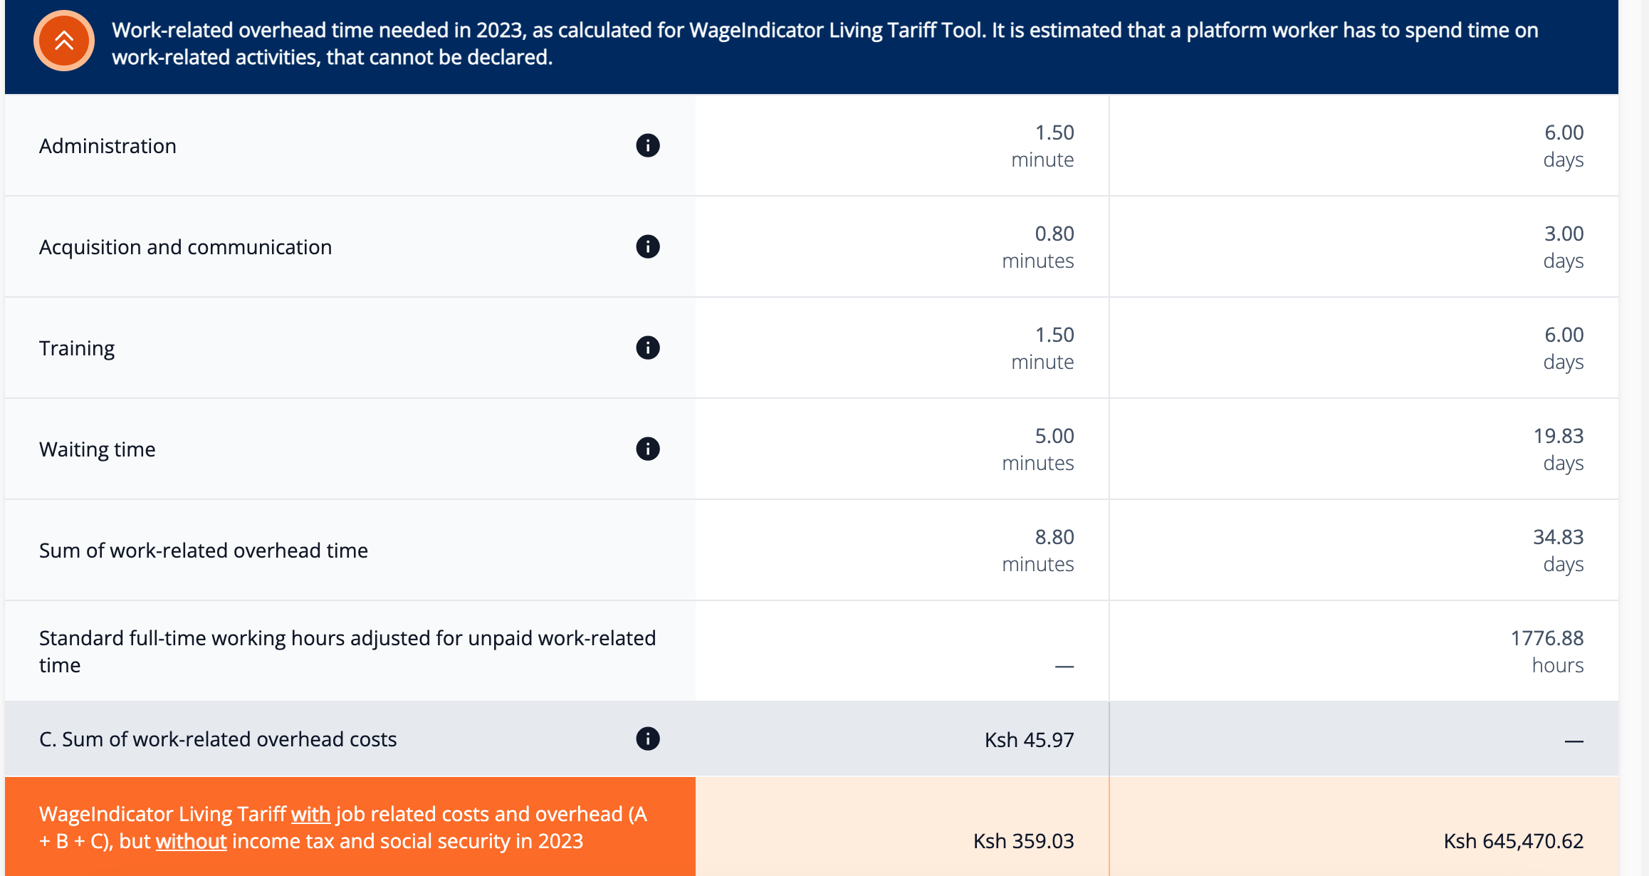






Screenshot from Living Tariff Tool Kenya - https://mywage.org/kenya/salary/living-wages/living-tariff-for-platform-workers-in-kenya (accessed on 19/1/2024)

Slide 11
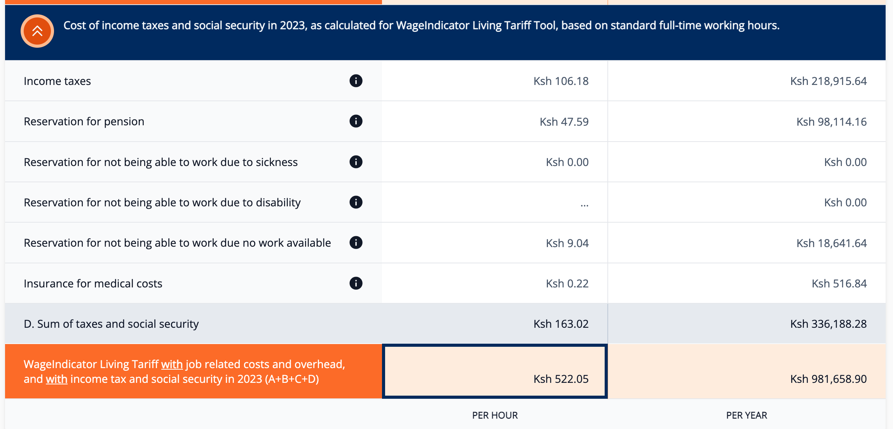


Screenshot from Living Tariff Tool Kenya - https://mywage.org/kenya/salary/living-wages/living-tariff-for-platform-workers-in-kenya (accessed on 19/1/2024)

Slide 12

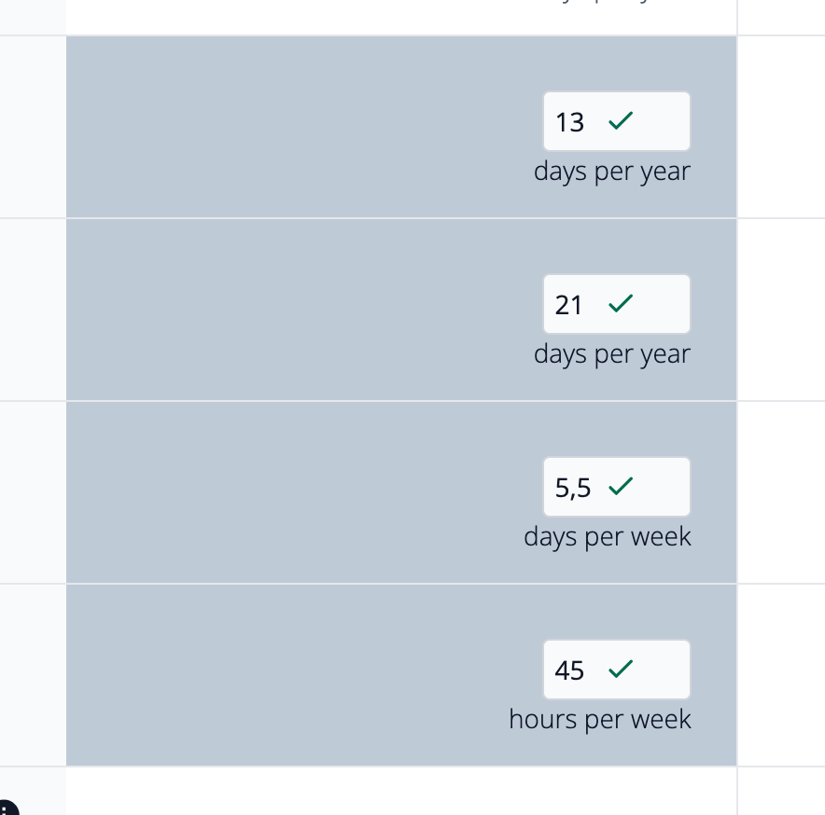
Screenshot from Living Tariff Tool Kenya - https://mywage.org/kenya/salary/living-wages/living-tariff-for-platform-workers-in-kenya (accessed on 19/1/2024)

Slide 13
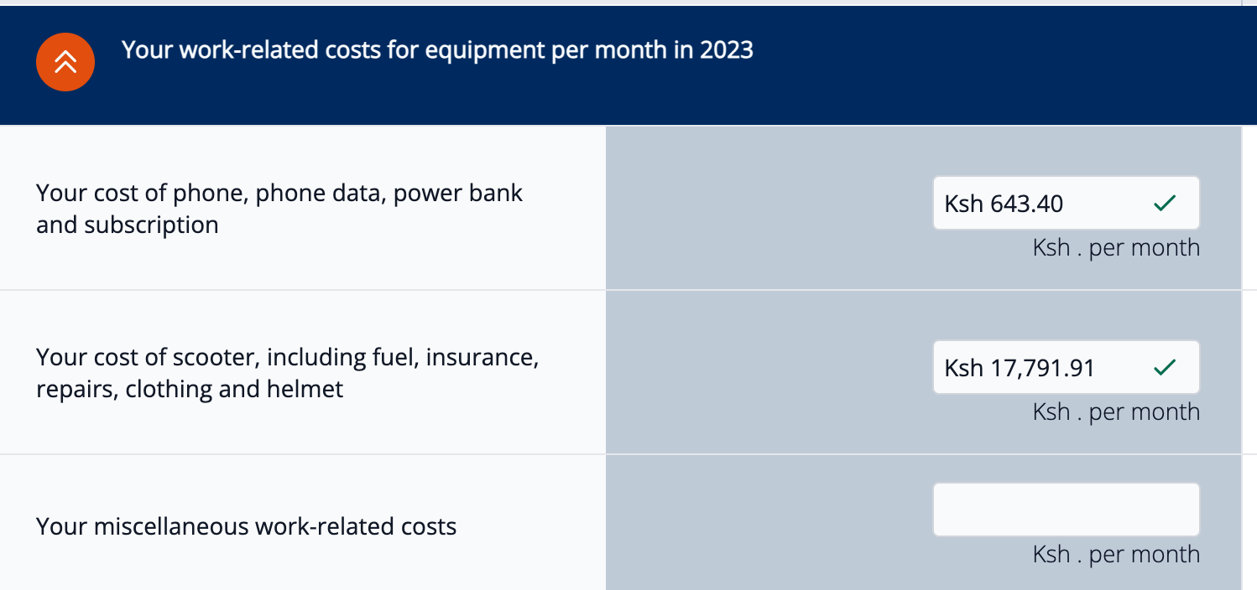
Screenshot from Living Tariff Tool Kenya - https://mywage.org/kenya/salary/living-wages/living-tariff-for-platform-workers-in-kenya (accessed on 19/1/2024)

Slide 14
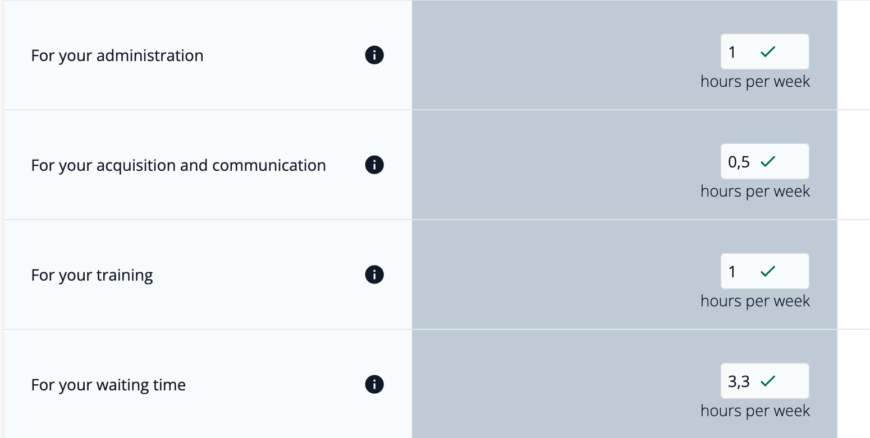
Screenshot from Living Tariff Tool Kenya - https://mywage.org/kenya/salary/living-wages/living-tariff-for-platform-workers-in-kenya (accessed on 19/1/2024)

Slide 15
THANK YOU
You can access the Living Tariff Tool and find more information here:
Video: https://youtu.be/Gn-pmosAQj8?si=-D8BskH3Xa_kaDkH
Webpage: https://wageindicator.org/salary/living-wage/living-tariff-7
Questions?
  paulienosse@wageindicator.org
  danielaceccon@wageindicator.org

